Slide 1
COPADS
2023 IFEOLUWATAYO IGE
#3 – Multithreading Basics

Slide 2
OUTLINE
Processes & Threads
Deadlock
InterProcess Communication
C# and Threads

Slide 3
Processes and Threads
A thread is an independent execution path, able to run simultaneously with other threads.
Threads are independent- means if there occurs exception in one thread, it doesn't affect other threads
Multithreading –Technique that allows for concurrent (simultaneous) execution of two or more parts of a program (threads) for maximum utilization of a CPU.
Most modern applications are multithreaded
A process is a group (1 or more) of threads that share a set of resources
Each thread has an ID, program counter, instruction pointer etc.
Single Threaded Process Vs Multithreaded Process

Slide 4
Resource Sharing among Threads

Slide 5
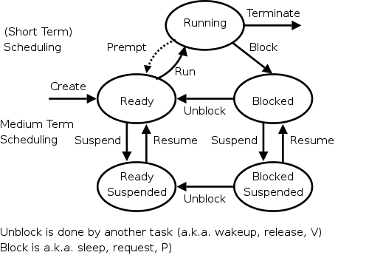
Thread State Diagram
Ready: waiting for be executed
Running: being executed by processor
ReadySuspended: in secondary memory due to lack of space in main memory
Blocked: resource unavailable, waiting for some event to occur. E.g I/O
Blocked suspended: are in secondary memory. Was initially in blocked state in main memory but no space so the movement.

Slide 6
Single Threaded versus Multithreaded Application Example
Using the Word Processor (Multithreaded)
Interaction thread with the user via keyboard
reformatting thread to reformat the whole document if deletion is done
Thread that helps to autosave the entire file to disk every few minutes
If it is a single-threaded application,
whenever a disk backup started, commands from the keyboard and mouse would be ignored until the backup was finished.
Sluggish
Having three separate processes is not possible because all three threads need to operate on the same document.
The threads share a common memory and so have access to the same document being edited

Slide 7
Thread Scheduling
When on a single processor, the scheduler just picks a new item from the queue and runs it.
If the time is exceeded, it preempts
On a multiprocessor system, the scheduler will pick the top thread from the thread queue to run if a processor is available.
They share a ready queue so that you don’t have to select which processor to run on
Means that 2 threads from same process can run at the same time

Slide 8
Thread coordination
Threads can communicate for free to sibling threads
Sometimes we need to restrict access to these shared resource
Exclusive access to shared data is done with a lock
Lock should only be used on shared resource
Need to be careful to avoid deadlocks
Notes:
If two threads are updating a bank account balance at the same time, we should put a lock on that section

Slide 9
Deadlocks
Thread A has resource M locked, and wants resource K
Thread B has resource K locked, and wants resource M
Need to use caution when writing mutlithreaded programs
Deadlocks may occur infrequently
When they do, they are extremely difficult to track down and may be quite challenging to reproduce to fix
In other words, two (or more) threads are trying to access a resource locked by another thread, and neither can proceed
Notes:
Draw the traffic left turn issue

Slide 10
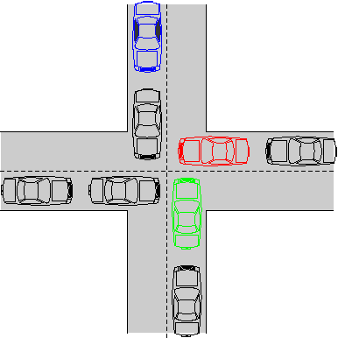
Deadlocks
Resource is the road – only one car can occupy a space of pavement at a time
Red car is blocked by the car in front (and can’t move)
Green car is blocked by Red Car
Blue care prevents the one in front from backing up
No cars are able to move
Red car can turn right, but what if the top and right roads were one-way?
Will revisit solutions to deadlocks in the coming weeks, including more details on the causes and solutions

Slide 11
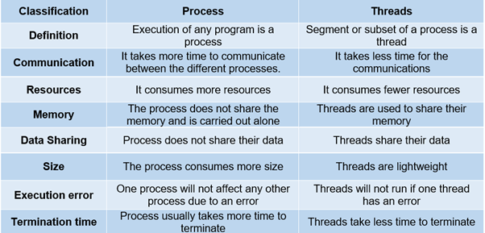
Key Differences

Slide 12
InterProcess Communication
Shared Resources, files in Memory
Remote Procedure Call
Network Protocols

Slide 13
IPC - Message Passing
Processes in the same system can send messages to another process.
Remote process needs to have a way to receive messages
Ability to send distributed messages to multiple receivers using Networking protocols
Two key networking protocols (WEEK 6)
TCP (Transmission Control Protocol) – using streams, reliable, slower
UDP (User Datagram Protocol) – using Datagrams, unreliable, faster
Can be used on the local machine or a remote machine
Able to work across platforms and architectures

Slide 14
IPC – Remote Procedure Call
Ability to run a function on another (or local) computer as if it were local
Also called Remote Method Invocation (RMI)when used in an object-oriented application
This involves writing object-oriented programming in which objects on different computers can interact in a distributed network.
Allows calling of methods on remote objects
Example is online e-commerce applications

Slide 15
Shared Resources, Files in Memory
Mutual Exclusion/Lock
process locks resources and uses.
Process can only release the lock when ready
Semaphores-signal mechanism. A variable that indicates the availability of a resource or not depending on its value.
Just like a resource counter
restricts the number of simultaneous users of a resource up to a maximum number.
Processes can request access to the resource (decrementing the semaphore), and can signal that they have finished using the resource (incrementing the semaphore )
Example: A toilet with one Key
Many toilets with identical Keys, incremented or decremented semaphore when users take or return keys.

